Slide 2

MUSIC GENRE
IDENTIFICATION
using Machine Learning
By: AKHIL ROCK BABU
Reg No: MAC23MCA-2010
Under the guidance of:
Prof. Manu John
This presentation uses a free template provided by FPPT.com
www.free-power-point-templates.com

Slide 3

CONTENTS
INTRODUCTION
LITERATURE REVIEW
COMPARISON
PROPOSED SYSTEM
DATASET DESCRIPTION
DATASET EXPLORATION
7. DATA VISUALIZATION
8. ALGORITHMS
9. PACKAGES
10. TIMELINE

Slide 4
INTRODUCTION
With the amount of digital music available today, Organising audio files is a challenging task and important for various applications.
Objectives:
Develop a machine learning model to classify music genres based on audio features.
Improve accuracy and efficiency in genre classification compared to traditional methods.
Provide a scalable solution that can handle large music libraries.

Slide 5
INTRODUCTION
To Identify these Music Genres:
Rock
Jazz
HipHop
pop
Classical
Blues
Country
Disco
Reggae
Metal

Slide 6
INTRODUCTION
Applications:
Enhances music recommendation systems
Organizes music libraries
Aids musicological research
Supports digital music streaming services
Facilitates personalized music experiences
Improves metadata accuracy in music databases

Slide 7
LITERATURE REVIEW 1
TITLE | ABOUT | DATASET | ALGORITHM | ACCURACY
Music Genre Classification: A Review of Deep-Learning and Traditional Machine-Learning Approaches | Ndou, N., Ajoodha, R., & Jadhav, A 2021 IEEE International IOT, Electronics and Mechatronics Conference(IEMTRONICS) | GTZAN dataset 9990 Records & 60 features | K-Nearest neighbor | 92.69%
Music Genre Classification: A Review of Deep-Learning and Traditional Machine-Learning Approaches | Ndou, N., Ajoodha, R., & Jadhav, A 2021 IEEE International IOT, Electronics and Mechatronics Conference(IEMTRONICS) | GTZAN dataset 9990 Records & 60 features | Support Vector Machine | 80.80%
Music Genre Classification: A Review of Deep-Learning and Traditional Machine-Learning Approaches | Ndou, N., Ajoodha, R., & Jadhav, A 2021 IEEE International IOT, Electronics and Mechatronics Conference(IEMTRONICS) | GTZAN dataset 9990 Records & 60 features | Convolutional Neural Network | 72.40%
This presentation uses a free template provided by FPPT.com
www.free-power-point-templates.com

Slide 8
LITERATURE REVIEW 2
TITLE | ABOUT | DATASET | ALGORITHM | ACCURACY
Music Genre Classification using Machine Learning | Prajwal, Shubham, Naik, & Sugna, "Music Genre Classification Using Machine Learning, IRJMETS | GTZAN dataset 9990 Records & 60 features | Support Vector Machine | 76.4%
Music Genre Classification using Machine Learning | Prajwal, Shubham, Naik, & Sugna, "Music Genre Classification Using Machine Learning, IRJMETS | GTZAN dataset 9990 Records & 60 features | K-Nearest Neighbors | 69.6%
Music Genre Classification using Machine Learning | Prajwal, Shubham, Naik, & Sugna, "Music Genre Classification Using Machine Learning, IRJMETS | GTZAN dataset 9990 Records & 60 features | Random Forest | 66.4%
This presentation uses a free template provided by FPPT.com
www.free-power-point-templates.com

Slide 9
LITERATURE REVIEW 3
TITLE | ABOUT | DATASET | ALGORITHM | ACCURACY
Comparison of SVM, KNN, and NB Classifier for Genre Music Classification based on Metadata | Setiadi Et al. 2020 International Seminar on Application for Technology of Information and Communication (iSemantic). | Spotify music dataset from www.crowdai.org | Support Vector Machine | 80%
Comparison of SVM, KNN, and NB Classifier for Genre Music Classification based on Metadata | Setiadi Et al. 2020 International Seminar on Application for Technology of Information and Communication (iSemantic). | Spotify music dataset from www.crowdai.org | K-Nearest Neighbors | 75.61%
Comparison of SVM, KNN, and NB Classifier for Genre Music Classification based on Metadata | Setiadi Et al. 2020 International Seminar on Application for Technology of Information and Communication (iSemantic). | Spotify music dataset from www.crowdai.org | Naive Bayes | 75.05%
This presentation uses a free template provided by FPPT.com
www.free-power-point-templates.com

Slide 10
LITERATURE SUMMARY
TITLE | DATASET | ALGORITHM | ACCURACY
Music Genre Classification: A Review of Deep-Learning and Traditional Machine-Learning Approaches | GTZAN dataset 10000 Records & 60 features | K-Nearest neighbor | 92.69%
Music Genre Classification using Machine Learning | GTZAN dataset 10000 Records & 60 features | Support Vector Machine | 76.4%
Music Genre Classification using Machine Learning | GTZAN dataset 10000 Records & 60 features | Support Vector Machine | 76.4%
Comparison of SVM, KNN, and NB Classifier for Genre Music Classification based on Metadata | Spotify music dataset from www.crowdai.org | Naive Bayes | 75.05%
This presentation uses a free template provided by FPPT.com
www.free-power-point-templates.com

Slide 11
PROPOSED SYSTEM
To develop and optimize a enhanced music genre classification system using machine learning algorithms such as KNN, SVM, and NB.
Compare the performance of these models to determine the most accurate one.
Create a user-friendly web interface for users to input audio files and obtain Genre Assignment.

Slide 12
PROPOSED SYSTEM
The project will follow a structured methodology which includes data preprocessing, model development, training, evaluation, and deployment.
Data Preprocessing: It includes Handling Missing Values, Normalization, Feature Selection
Model Development : Using KNN, SVM, NB.
Model Training :The dataset will be split into training data and testing data (80% and 20% respectively).

Slide 13
PROPOSED SYSTEM
Model Evaluation : Trained models will be evaluated.
Model Deployment : The trained model will be integrated with the web application created using flask.
Conclusion: Comparison of KNN, SVM, and NB for high-accuracy genre classification.

Slide 14
DATASET DESCRIPTION
Dataset: GTZAN dataset (1,000 tracks, 10 genres) which is easily available on kaggle respository.
Features Extracted:
Chroma Feature (chroma_stft)
Root Mean Square Value (rms)
Spectral Features: Centroid, bandwidth, contrast, rolloff.
Zero Crossing Rate
Harmony and Perceived Pitch
Tempo
Mel-Frequency Cepstral Coefficients(MFCCs)

Slide 15
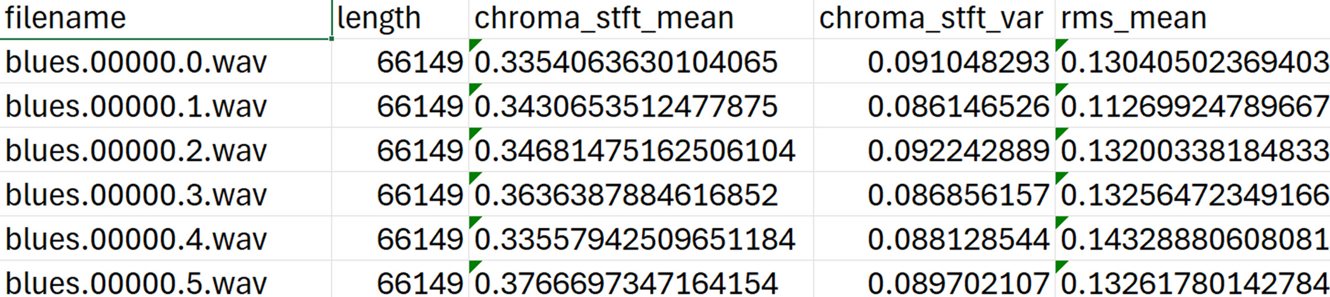
DATASET DESCRIPTION
DATASET SAMPLE
Dataset Link: https://www.kaggle.com/datasets/andradaolteanu/gtzan-dataset-music-genre-classification

Slide 16
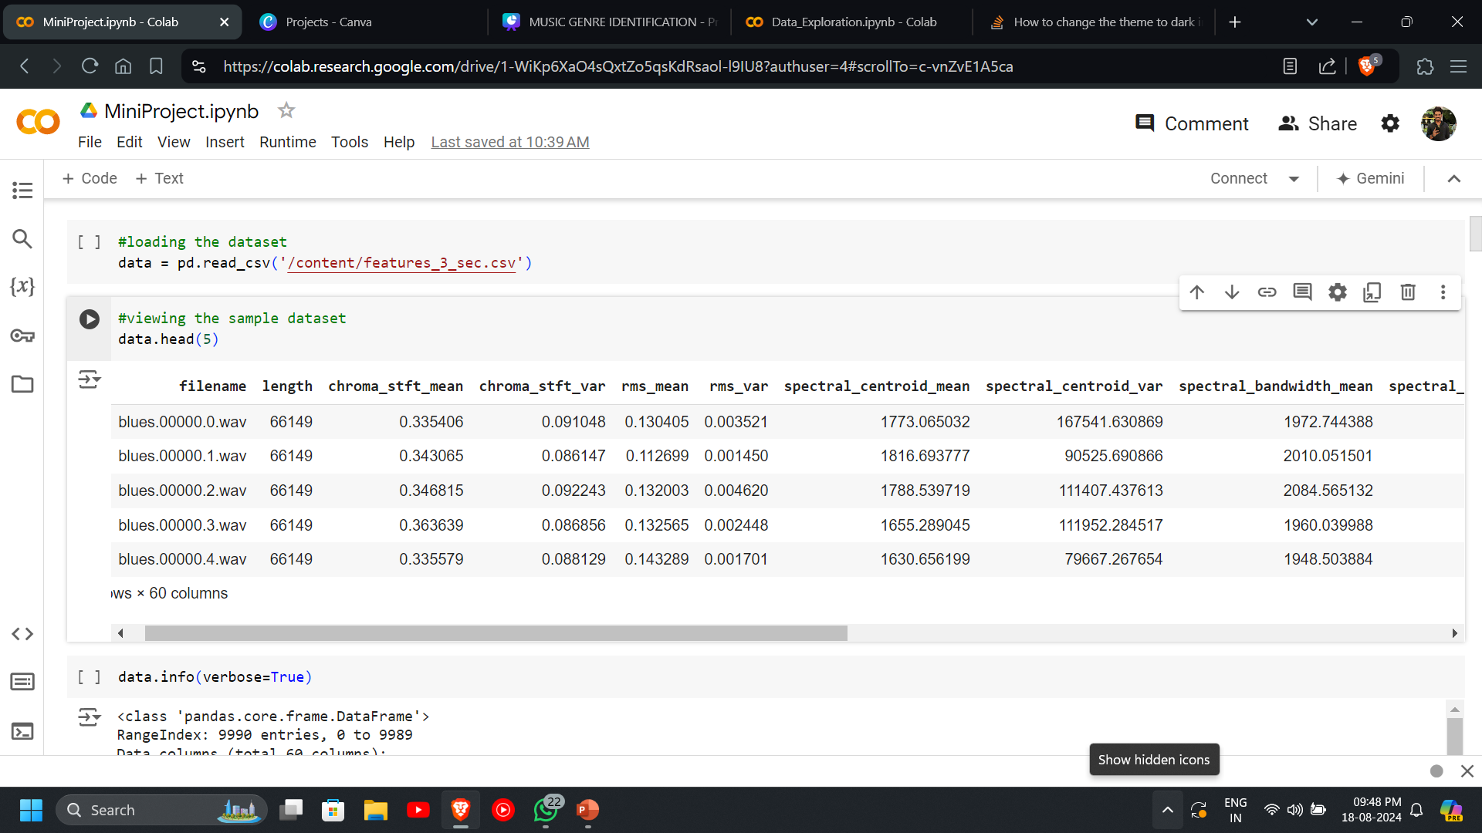
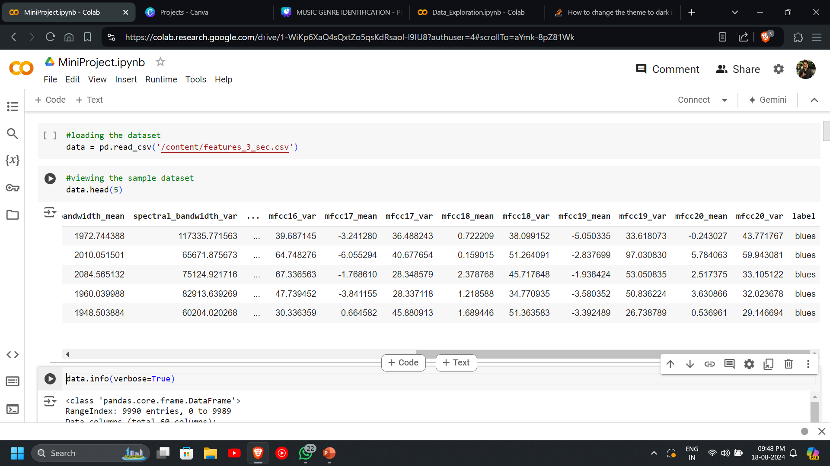
DATASET EXPLORATION
Dataset has 9990 records and 60 features including the target feature.

Slide 17
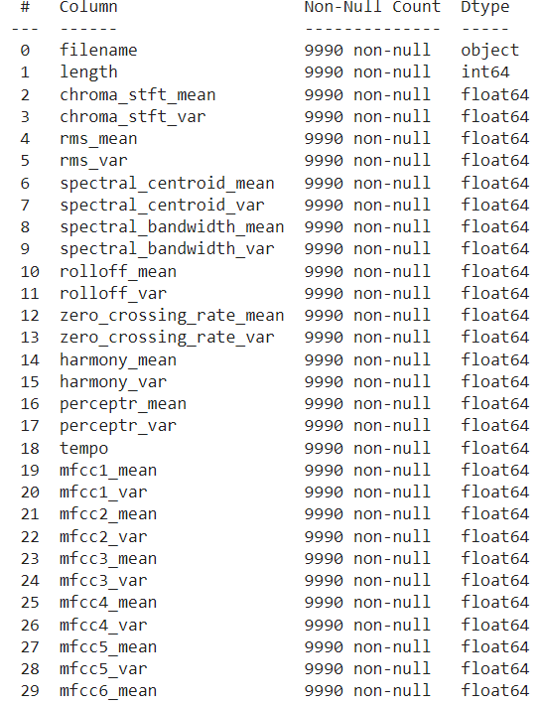
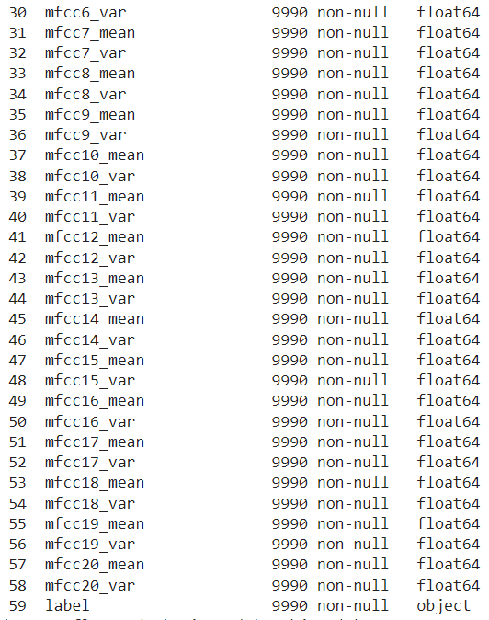
CONTINUES...
58 Numerical attributes and 1 categorical attributes

Slide 18
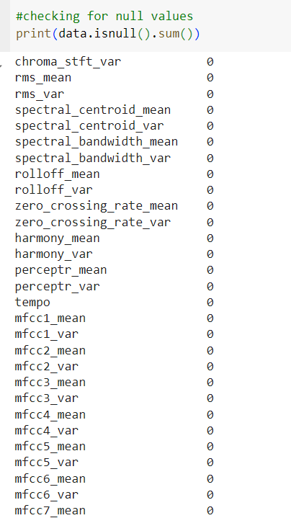
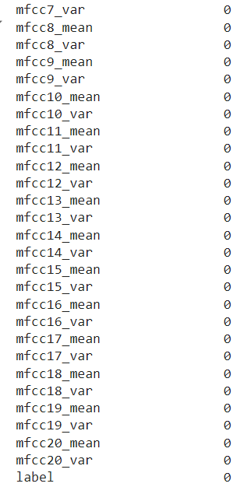
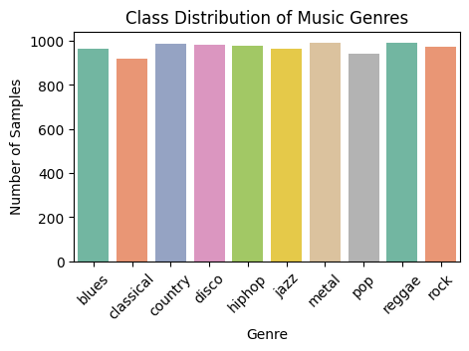
CONTINUES...
Dataset is almost balanced
Dataset also doesn’t contain any null values

Slide 19
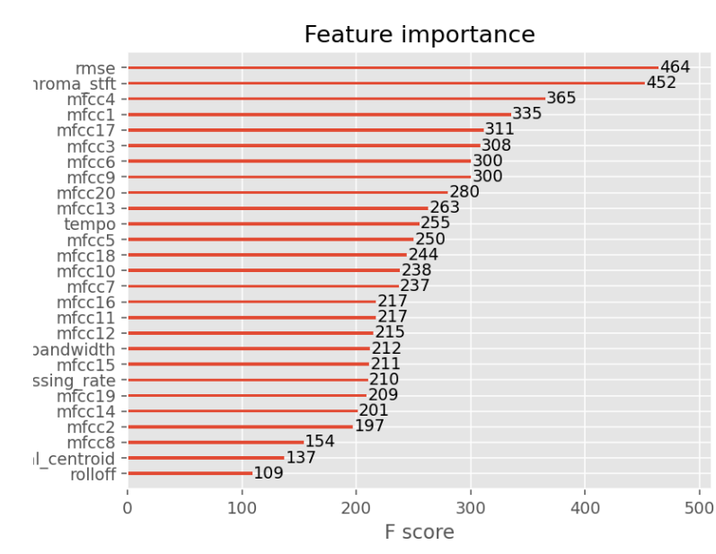
CONTINUES...
FEATURE SELECTION
Used chi-square method to find relevant features
As training irrelevant features is time consuming and can lead to an unnecessary increase in complexity of the model
Selecting 38 relevant features which gives highest accuracy

Slide 20
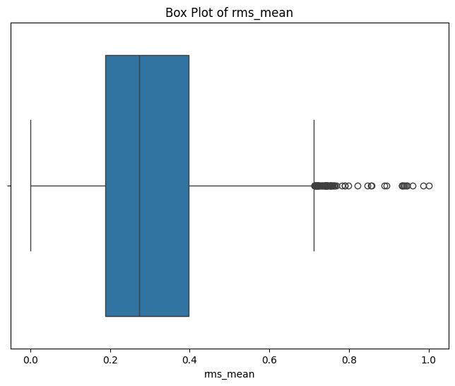
CONTINUES...
HANDLING OUTLIERS
rms_means above 0.78 are considered as outliers and is treated.

Slide 21
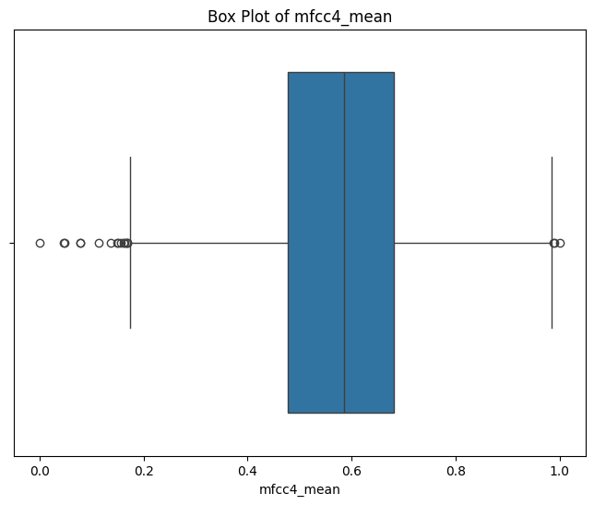
CONTINUES...
mfcc4_means below 0.18 are considered as outliers and is treated.

Slide 22
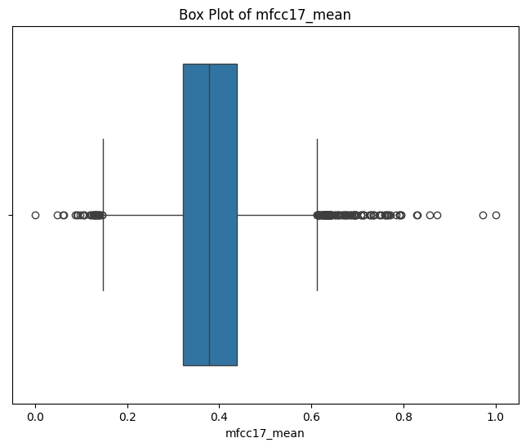
CONTINUES...
mfcc17_means below 0.1 and above 0.8 are considered as outliers and is treated.

Slide 23
CONTINUES...
CLASS IMBALANCE
The Class labels are almost balanced
The small variation present here is not significant enough to be considered a class imbalance

Slide 24
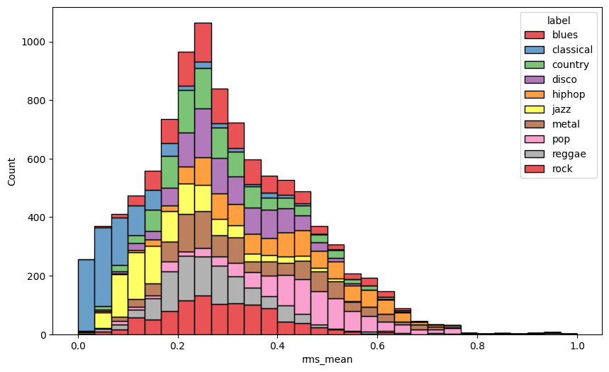
DATA VISUALIZATION
most audio files have an rms_mean value in 0.2 to 0.3
Classical music tends to have lower rms_mean values, while rock and metal are skewed towards higher values.

Slide 25
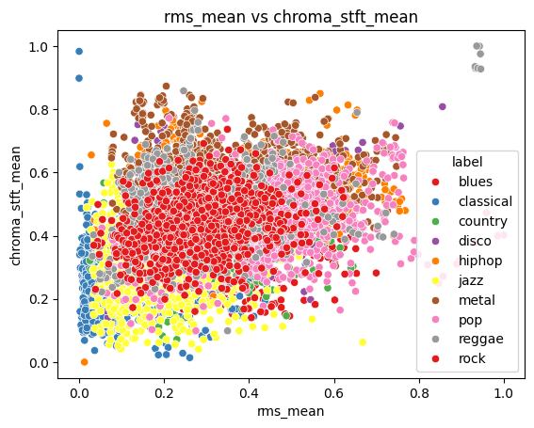
CONTINUES...

Slide 26
CONTINUES...
Classical and reggae show more distinct clustering, which could be useful for classification.
Rock, pop, jazz, and disco show significant overlap, indicating the need for additional features to differentiate these genres effectively.
Classical music typically has lower energy and chroma-based features, as indicated by rms_mean and chroma_stft_mean, clustering predominantly in the lower range.

Slide 27
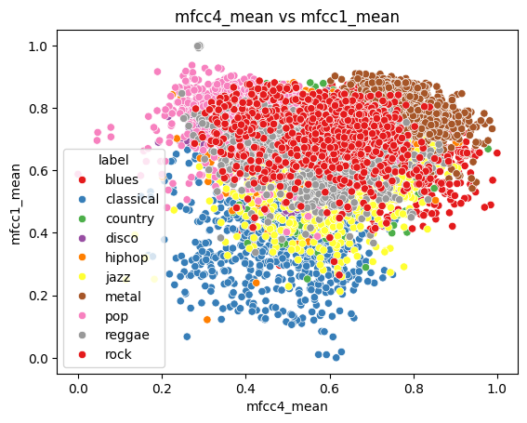
CONTINUES...
Classical and reggae show more distinct clustering, which could be useful for classification.
The overlap between some genres suggests that current features may not be enough to accurately differentiate them

Slide 28
CONTINUES...
The analysis of multiple audio features, shows that individual features don't guarantee perfect classification, but when combined, distinct patterns emerge, making genres increasingly separable.
Multi-feature analysis enhances the model's ability to differentiate genres by capturing the complexity and diversity of musical characteristics, reducing overlapping observed in single features.

Slide 29
ALGORITHMS
K-Nearest Neigbour (KNN)
KNN is a simple, algorithm used for both classification and regression tasks.
KNN classifies a data point by considering the classes of its closest neighbors in the feature space.
KNN predicts the category of a data point based on the majority class among its nearest neighbors.

Slide 30
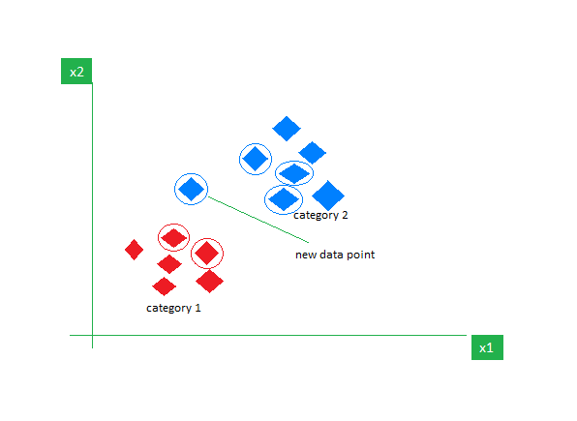
ALGORITHMS
Red and blues are two classes
New datapoints are represented by white circles
Calculate the distance between points and take the K nearest points
assign class which have majority of count in K nearest neighbours

Slide 31
CONTINUES...
How does KNN algorithm works ?
Choose the number of nearest neighbors, K, which is a critical hyperparameter in the algorithm.
Compute the distance between the test data point and all points in the training dataset.
Arrange the calculated distances in ascending order to identify the closest neighbors.
Pick the top K nearest data points based on the sorted distances.
Assign the most common class among the K neighbors

Slide 32
CONTINUES...
Pseudocode
Input:
- Training data (X_train, y_train)
- Test data point (X_test)
- Number of neighbors (K)
Output:
- Predicted class label or value for X_test
Steps:
1. For each point (X_test) in the test dataset:
a. Calculate the distance between X_test and all points in the training dataset:
- For i = 1 to len(X_train):
- Compute distance d = distance(X_test, X_train[i])
- Store the distance and the corresponding label of X_train[i]

Slide 33
CONTINUES...
b. Sort the calculated distances in ascending order.
c. Select the top K entries from the sorted list.
- For classification:
- Count the number of occurrences of each class in the top K entries.
- Assign the class with the highest count as the predicted class.
e. Return the predicted class label or value.
End

Slide 34
CONTINUES...
SUPPORT VECTOR MACHINE (SVM)
•Supervised learning technique.
•SVM finds a hyperplane that best separates the two classes.
•There can be infinite number of hyperplanes passing through a point and classifiying the classes perfectly.
•The best hyperplane is the one with maximum marginal distance.
•The main objective of the SVM algorithm is to find the optimal hyperplane in an N-dimensional space that can separate the data points in different classes.

Slide 35
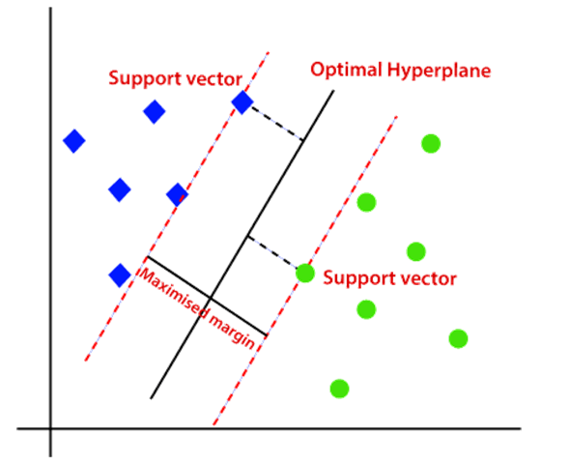
CONTINUES...
•There can be multiple lines/decision boundaries to segregate the classes in n-dimensional space, but we need to find out the best decision boundary that helps to classify the data points.

Slide 36
CONTINUES...
SVM identifies extreme data points, called support vectors, which are critical in creating the hyperplane.
SVM can ignore outliers while finding the hyperplane that maximizes the margin, making it robust.
SVM uses soft margins to handle cases with outliers, allowing for some misclassifications.
Handles data that is not linearly separable by using kernel functions to transform the input data into a higher-dimensional space, where a linear SVM can then find a nonlinear decision boundary.

Slide 37
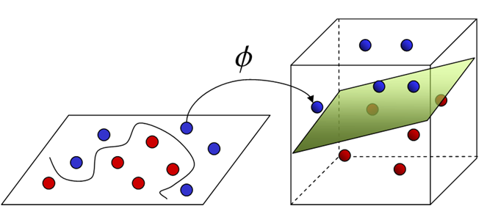
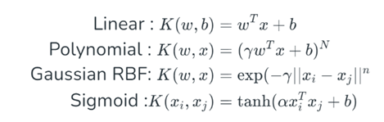
CONTINUES...
•The SVM kernel is a function that takes low-dimensional input space and transforms it into higher-dimensional space, i.e. it converts nonseparable problems to separable problems.

Slide 38
CONTINUES...
How does SVM algorithm works ?
·Gather dataset which consists of feature inputs and corresponding outputs.
SVM finds a hyperplane that best separates the two classes.
·Represent each data point as a vector in a multi-dimensional space, where each dimension corresponds to a feature of the data.
·Find the hyperplane that maximizes this margin, ensuring the best possible separation between the two classes.
·If the data is not linearly separable, the original feature space is mapped into a higher-dimensional space by using kernel trick where a linear hyperplane can separate the classes.

Slide 39
CONTINUES...
·Find the weights and bias that define the hyperplane by maximizing the margin and minimizing the classification errors.
·Once trained, the SVM model can classify new data points. For each new point, the model checks on which side of the hyperplane the point falls.

Slide 40
CONTINUES...
Pseudocode
1. Initialize Parameters:
- Set the regularization parameter C.
- Initialize weights w and bias b to 0 or small random values.
2. Repeat for a fixed number of iterations:
a. For each data point (xi, yi) in the training set:
i. Calculate the decision function: f(xi) = w * xi + b
ii. If the data point is misclassified (i.e., yi * f(xi) < 1):
- Update weights: w = w + C * yi * xi
- Update bias: b = b + C * yi

Slide 41
CONTINUES...
3. Prediction:
- For a new data point x_new, compute:
f(x_new) = w * x_new + b
- Return the predicted class:
if f(x_new) >= 0, return +1
else return -1

Slide 42
CONTINUES...
Naive’s Bayes (NB)
Naive Bayes is based on Bayes' Theorem, making it a simple yet effective probabilistic classifier.
Assumes strong independence between features, known as the "naive" assumption.
Despite its simplicity, it works well in real-world applications, especially in text classification tasks like spam filtering, sentiment analysis, and document categorization.

Slide 43
CONTINUES...
How does NB algorithm works ?
Compute the prior probability for each class based on the training data.
For each feature, calculate the likelihood of the feature value given each class.
Combine the prior and likelihood to calculate the posterior probability for each class.
Assign the data point to the class with the highest posterior probability.
Assumes that features are conditionally independent given the class.

Slide 44
CONTINUES...
Pseudocode
Input:
- Training data (X_train, y_train)
- Test data point (X_test)
Output:
- Predicted class label for X_test
Steps:
1. For each class C_i in the dataset:
a. Compute the prior probability P(C_i) from the training data:
- P(C_i) = (Number of instances in C_i) / (Total number of instances)
b. For each feature x_j in X_test:
- Compute the likelihood P(x_j | C_i):
- For categorical data, use frequency counts.

Slide 45
CONTINUES...
- For continuous data, assume Gaussian distribution and calculate using the formula.
c. Compute the posterior probability P(C_i | X):
- P(C_i | X) ∝ P(X | C_i) * P(C_i)
- P(X | C_i) = Product of all likelihoods P(x_j | C_i) for each feature x_j.
2. Assign the class label to X_test that has the highest posterior probability.
End

Slide 46
Packages and Built-in Functions Used
• Pandas
- read_csv()
- head()
- shape()
- info()
- drop()
- value_counts()
- isnull()
- describe()
- tail()
• Matplotlib
- figure()
- title()
- show()
- xlabel()
- ylabel()
• Librosa
- librosa.feature.rms()
- librosa.feature.chroma_stft()
- librosa.feature.mfcc()
- librosa.beat.tempo()
• Seaborn
- boxplot()
- countplot()
- heatmap()
- scatterplot()
• Numpy
• Numpy

Slide 47
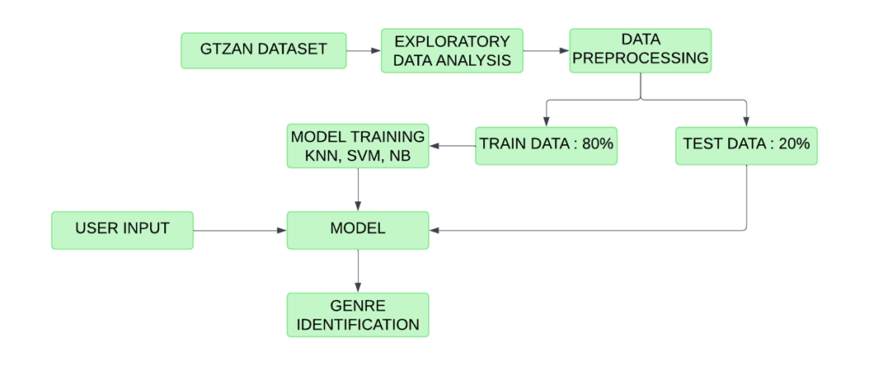
PIPELINE DIAGRAM

Slide 48
TIMELINE
•Sprint release 1
- Model building using KNN
•Sprint release 2
- Model building using SVM
- Model building using NB
•Sprint Release 3
Interface design
deployment

Slide 49
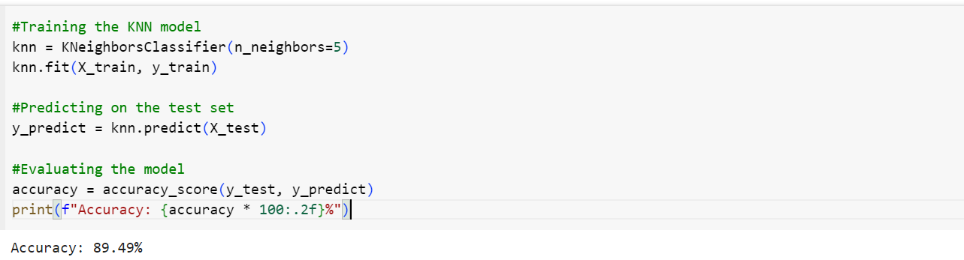
SYSTEM DESIGN
Model Training
•The dataset is divided into training(80 %) and testing(20 %) data.
KNN MODEL
The model considers the 5 nearest neighbors (k=5) for classification. The distance metric used is Euclidean distance, which calculates the straight-line distance between feature points.

Slide 50
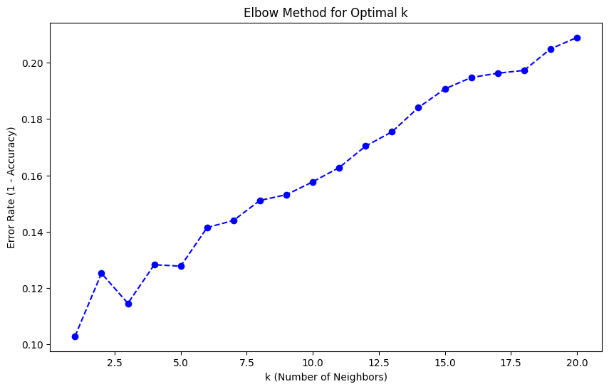
SYSTEM DESIGN
As the value of k increases beyond
k = 5, the error rate continues to increase.
Therefore, k = 5 appears to be the best choice for the KNN model based on this plot.

Slide 51
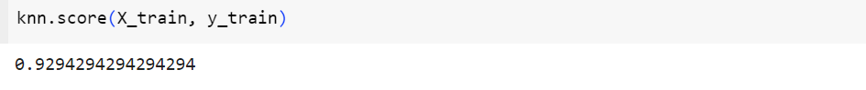
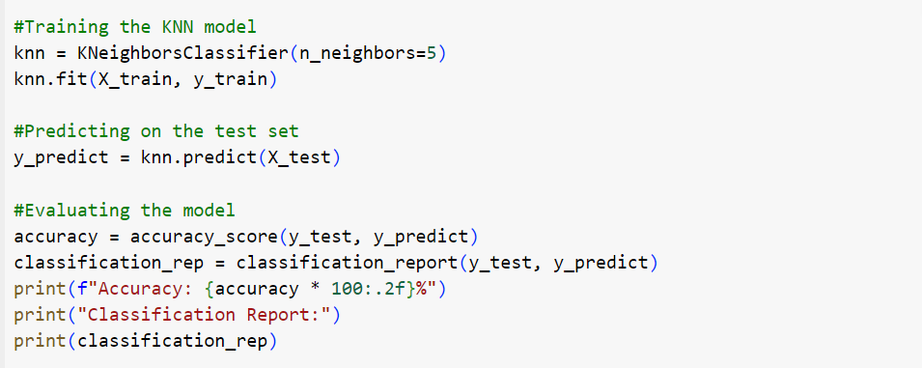
SYSTEM DESIGN
The model achieved an accuracy of 92.94% on the training data.

Slide 52
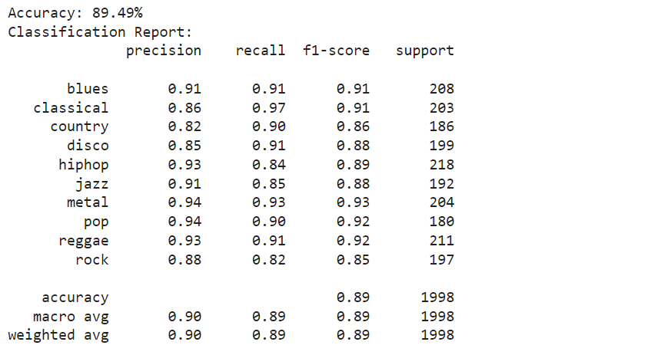
SYSTEM DESIGN
The model achieved an accuracy of 89.49% on the testing data.

Slide 53
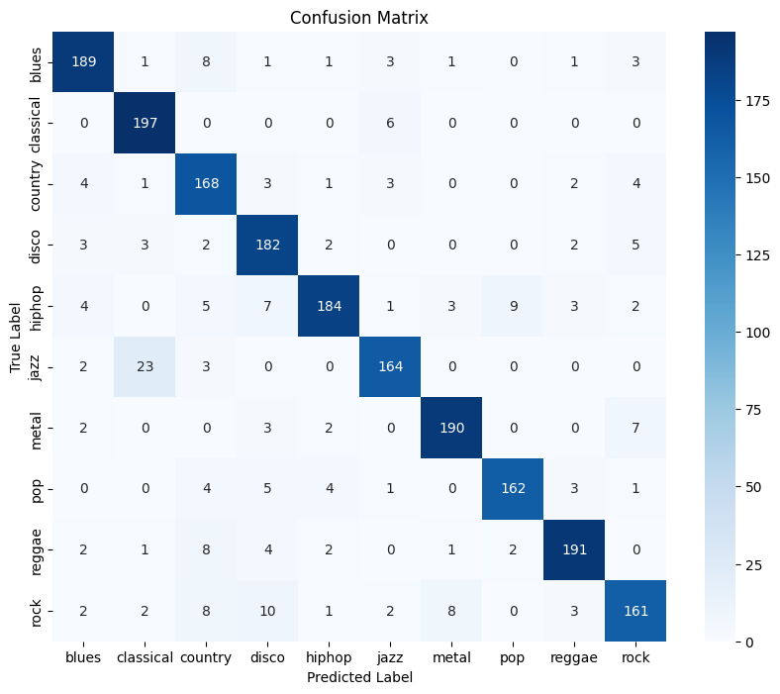
SYSTEM DESIGN

Slide 54
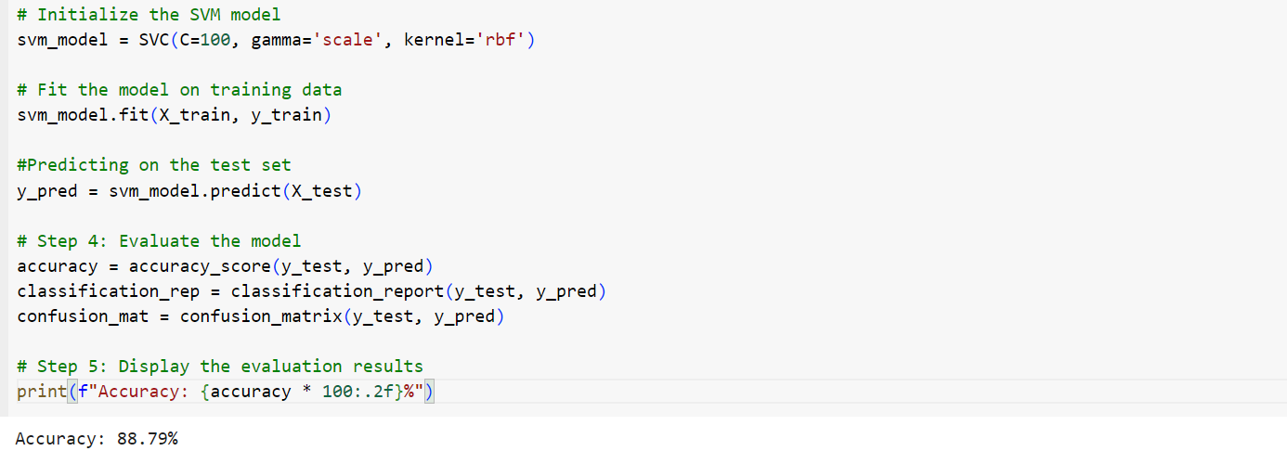
SYSTEM DESIGN
SVM MODEL
The best hyperparameters were selected using the GridSearchCV method, which systematically tested various combinations
The model uses the Radial Basis Function (RBF) kernel, which is effective for nonlinear classification tasks.

Slide 55
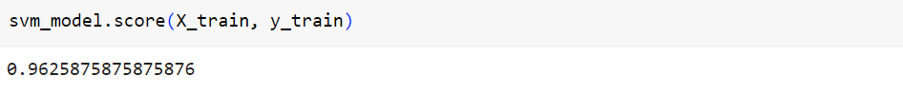
SYSTEM DESIGN
The C=100 parameter controls the regularization strength, balancing correct classification of training examples with maximizing the margin between classes
The gamma='scale' parameter defines the influence of individual training examples, adjusted automatically based on the feature dimensions to ensure an appropriate balance of model complexity.
The model achieved an accuracy of 96.25 % on the training data.

Slide 56
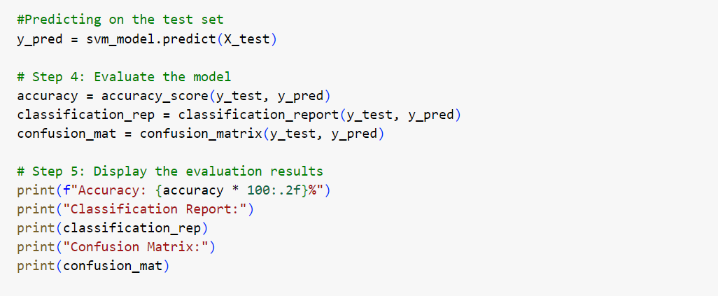
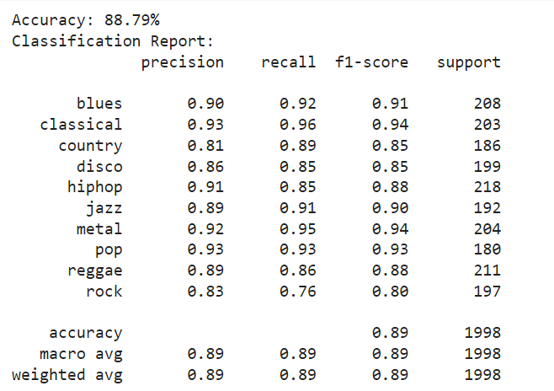
SYSTEM DESIGN
The model achieved an accuracy of 88.79 % on the testing data.

Slide 57
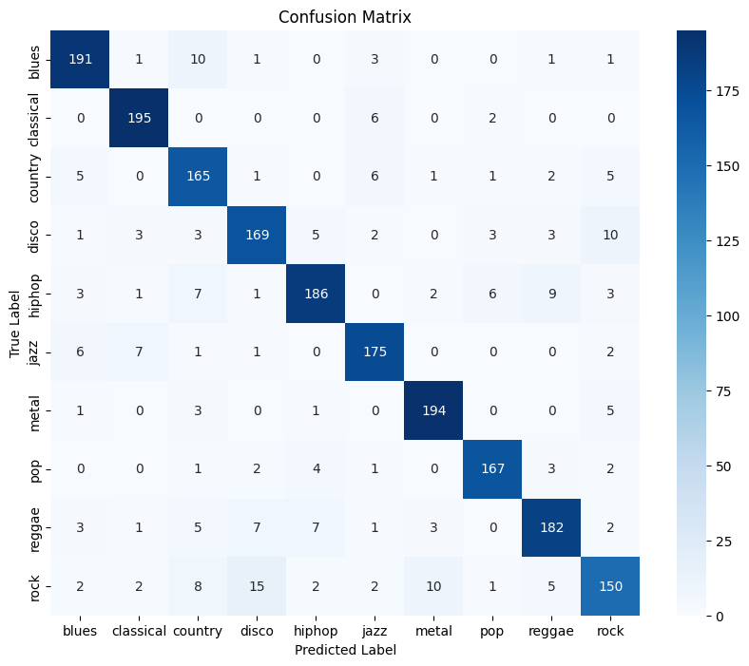
SYSTEM DESIGN

Slide 58
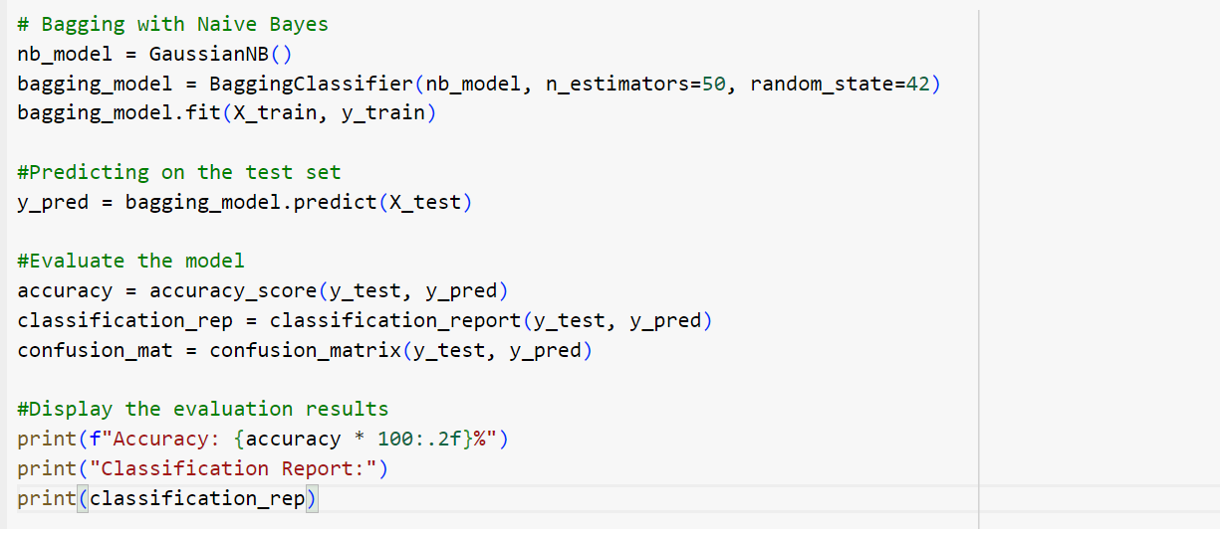
SYSTEM DESIGN
Naive Baye’s Model
To improve the model's accuracy and reduce variance, the Bagging method is applied, where 50 base models are trained on different random subsets of the training data.
The Bagging Classifier is initialized with 50 estimators and a random state of 42 to ensure reproducibility of results.

Slide 59
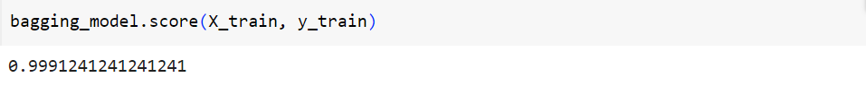
SYSTEM DESIGN
The model achieved an accuracy of 99.91 % on the training data

Slide 60
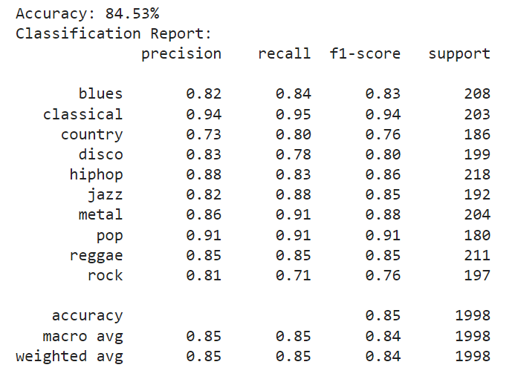
SYSTEM DESIGN
The model achieved an accuracy of 84.53 % on the testing data

Slide 61
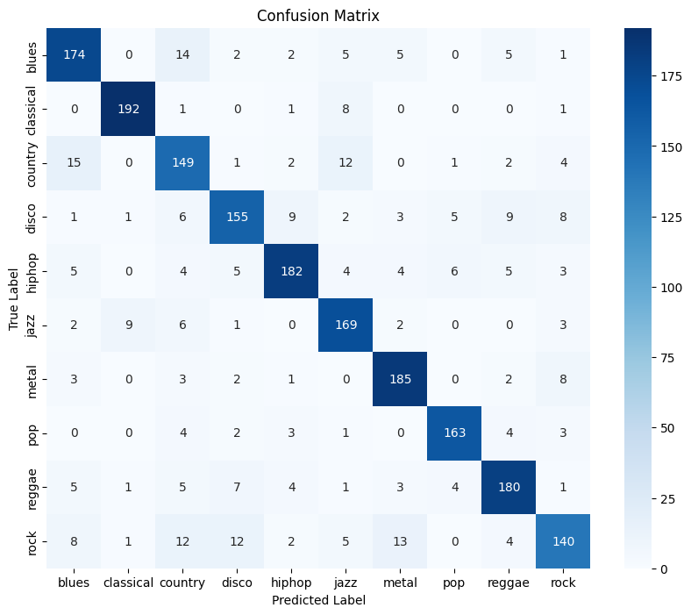
SYSTEM DESIGN

Slide 62
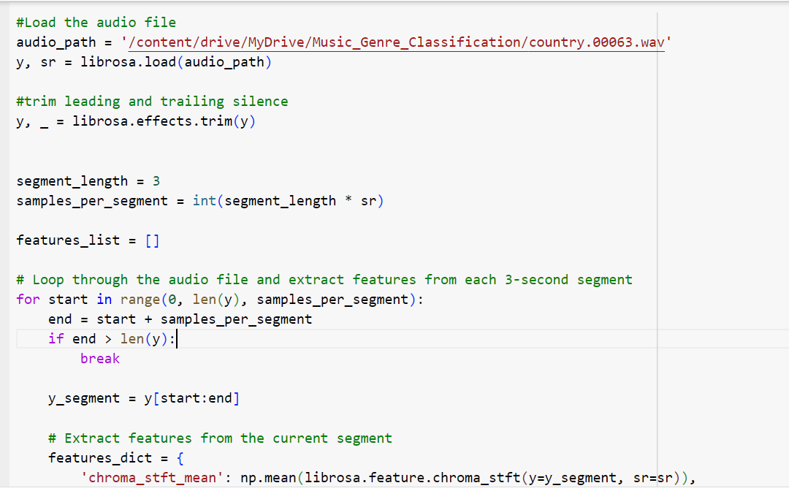
SYSTEM DESIGN
Testing with unseen data
Extracting audio features using python librosa package
splits the audio into 3 seconds segments and extracts the features for each segment
this process continues until the audio is completely divided into segments.

Slide 63
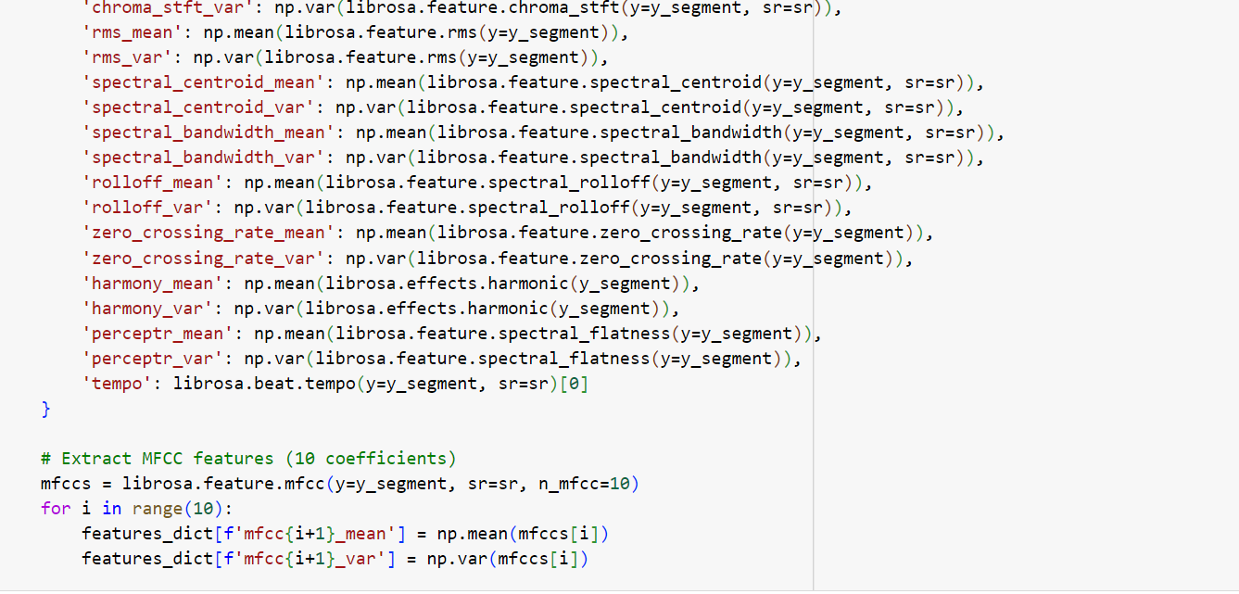
SYSTEM DESIGN

Slide 64
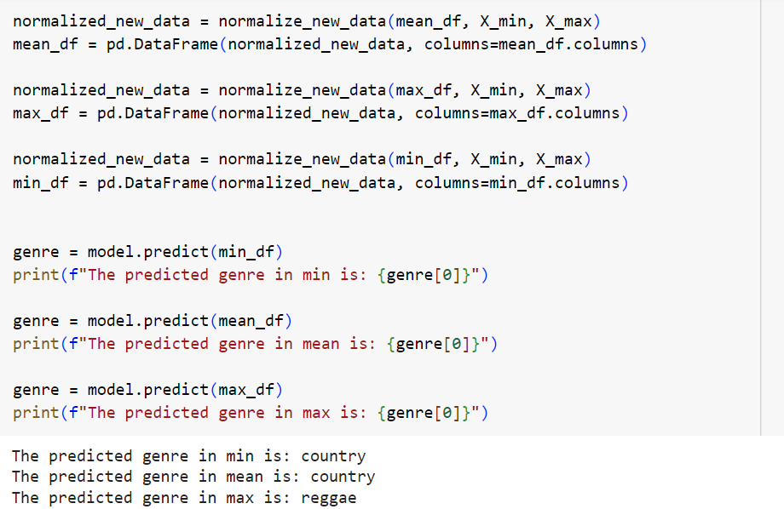
SYSTEM DESIGN
The extracted features are then noramalized using the same scale used for normalizing the training dataset.
The Minimum, Mean and Maximum values among the segments are taken and make predictions.
The class with majority count is assigned as the final class.

Slide 65
SUMMARY
Dataset - GTZAN Dataset containing Pre-extracted features of 1000 audio tracks distributed across 10 Music genres
Algorithms - Comparative Study of three Algorithms - KNN, SVM, and Naive Baye’s
Data Preprocessing
Feature Selection - 38 most relevant features are identified using chi-square method and selected
Dropping Duplicates - Duplicate values are detected and dropped
Outlier Handling - Outliers are detected and handled
Normalization - Applied Min-Max Normalization to scale features into same range (0 - 1)

Slide 66
SUMMARY
Splitting the Dataset - The dataset was split into training data (80%) and testing data (20%)
Model Building - Three Models are built using KNN, SVM and Naive Baye’s
Model Evaluation - Models are evaluated based on accuracy, precision, recall, F1-score
KNN and SVM found to be almost equally best performing on GTZAN Dataset
Deployment - Two Models (KNN and SVM) were combined to form the final result

Slide 67

GUI

Slide 68
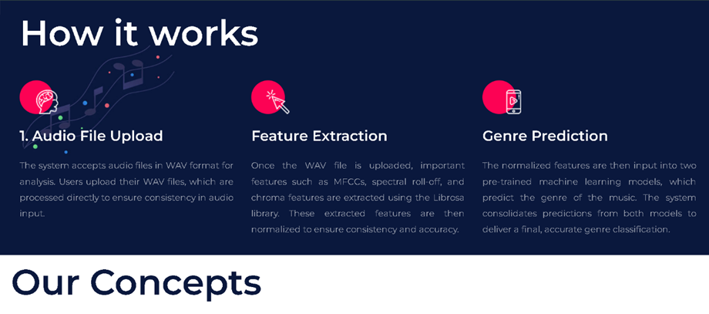
GUI

Slide 69

GUI

Slide 70

GUI

Slide 71

THANK YOU !
This presentation uses a free template provided by FPPT.com
www.free-power-point-templates.com

